Slide 1
12th Grade
Linear Algebra - Mathematics -
Here is where your presentation begins

Slide 2
Contents of this template
You can delete this slide when you’re done editing the presentation
Fonts | To view this template correctly in PowerPoint, download and install the fonts we used
Used and alternative resources | An assortment of graphic resources that are suitable for use in this presentation
Thanks slide | You must keep it so that proper credits for our design are given
Colors | All the colors used in this presentation
Icons and infographic resources | These can be used in the template, and their size and color can be edited
Editable presentation theme | You can edit the master slides easily. For more info, click here
For more info: Slidesgo | Blog | FAQs
You can visit our sister projects: Freepik | Flaticon | Storyset | Wepik | Videvo

Slide 3
Table of contents
01
02
03
04
Introduction to linear algebra
Matrix operations and arithmetic
You can describe the topic of the section here
You can describe the topic of the section here
Applications of linear algebra
Review and
practice problems
You can describe the topic of the section here
You can describe the topic of the section here

Slide 4
Whoa!
This can be the part of the presentation where you introduce yourself, write your email…

Slide 5
01
Introduction to linear algebra
You can enter a subtitle here if you need it

Slide 6
Introduction
Mercury is the closest planet to the Sun and the smallest one in the Solar System—it’s only a bit larger than the Moon. The planet’s name has nothing to do with the liquid metal, since Mercury was named after the Roman messenger god

Slide 7
What is the linear algebra
Mercury is the closest planet to the Sun and the smallest one in the entire Solar System. Contrary to popular belief, this planet's name has nothing to do with the liquid metal. Mercury was, instead, named after the famous Roman messenger god Mercurius
Mercury takes a little more than 58 days to complete its rotation, so try to imagine how long days must be there! Since the temperatures are so extreme, albeit not as extreme as on Venus, Mercury has been deemed to be non-habitable for humans

Slide 8
Vectors and
vector operations
Do you know what helps you make your point crystal clear? Lists like this one:
They’re simple
You can organize your ideas clearly
You’ll never forget to buy milk!
And the most important thing: the audience won’t miss the point of your presentation

Slide 9
What are the vector operations
Math operations
Vector coordinate
Mercury is the closest planet to the Sun and the smallest one in the Solar System—it’s only a bit larger than the Moon
Venus has a beautiful name and is the second planet from the Sun. It’s hot and has a poisonous atmosphere

Slide 10
Matrix basics and notation
Mercury
Venus
Mars
Mercury is the closest planet to the Sun and the smallest of them all
Venus has a beautiful name and is the second planet from the Sun
Despite being red, Mars is actually a cold place. It’s full of iron oxide dust

Slide 11
Matrix operations and arithmetic
Mars
Venus
Mars is actually a very cold place
Venus has extremely high temperatures
Jupiter
Saturn
Jupiter is the biggest planet of them all
Saturn is a gas giant and has several rings

Slide 12
Gaussian elimination
Venus
Neptune
Earth
Venus has extremely high temperatures
Neptune is very far away from the Sun
Earth is also known as the Blue Planet
Jupiter
Saturn
Jupiter is the biggest planet of them all
Saturn is not the only planet with rings

Slide 13
Linear equations and systems
Mars
Venus
Neptune
Mars is actually a very cold place
Venus has extremely high temperatures
Neptune is the farthest planet from the Sun
Mercury
Saturn
Jupiter
Mercury is the closest planet to the Sun
Saturn is a gas giant and has several rings
Jupiter is the biggest planet of them all

Slide 14
Awesome words

Slide 15
—Someone Famous
“This is a quote, words full of wisdom that someone important said and can make the reader get inspired”

Slide 16
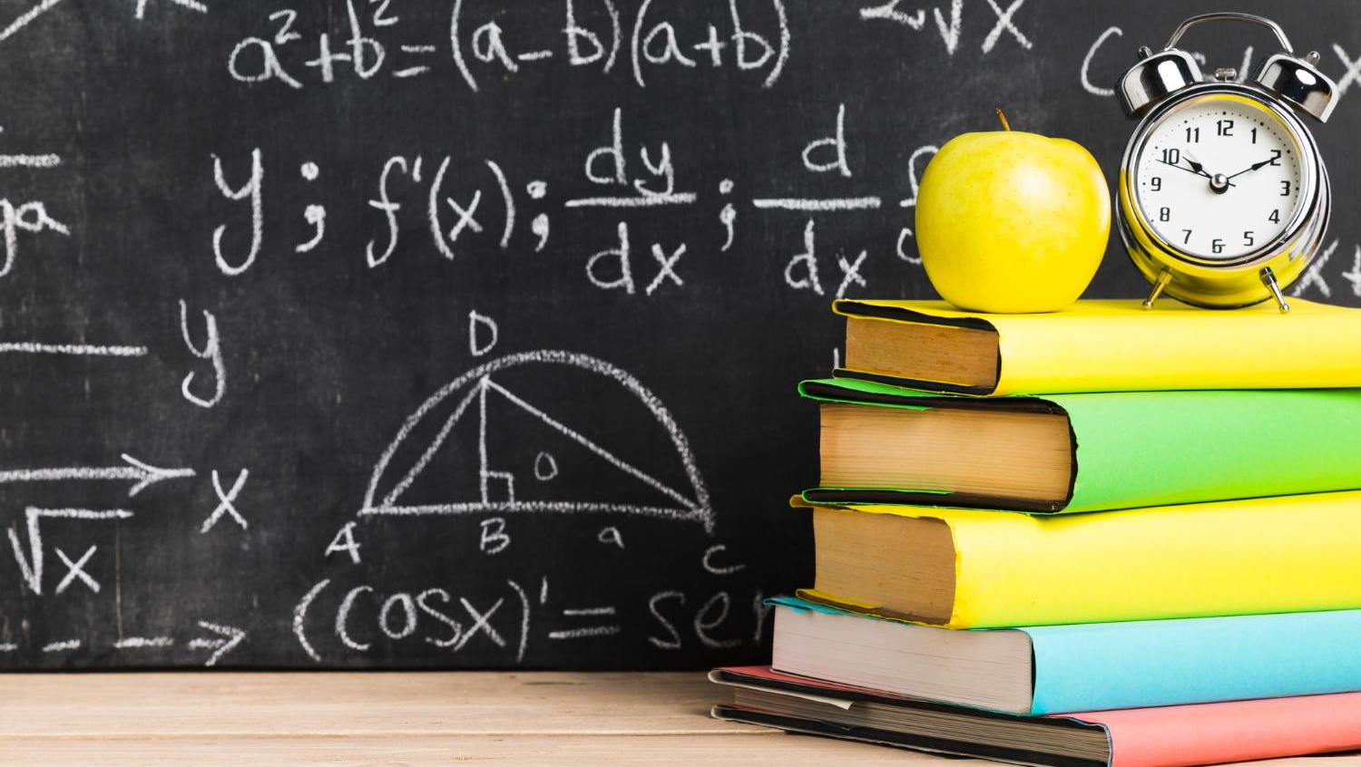
A picture is worth a thousand words

Slide 17
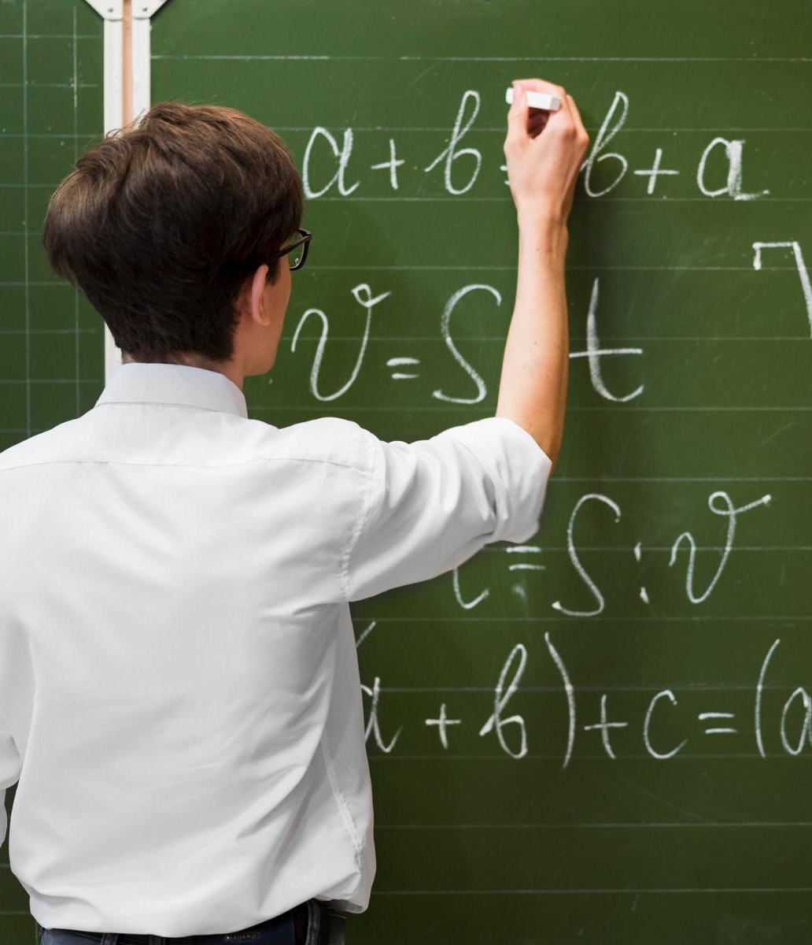
A picture always reinforces
the concept
Images reveal large amounts of data, so remember: use an image instead of a long text. Your audience will appreciate it

Slide 18
03
Applications of linear algebra
You can enter a subtitle here if you need it

Slide 19
98,300,000
Big numbers catch your audience’s attention

Slide 20
9h 55m 23s
333,000
386,000 km
Jupiter’s rotation period
The Sun’s mass compared to Earth’s
Distance between Earth and the Moon

Slide 21
Let’s use some percentages
25%
50%
75%
Mercury
Venus
Mars
Mercury is the closest planet to the Sun and the smallest of them all
Venus has a beautiful name and is the second planet from the Sun
Despite being red, Mars is actually a cold place. It’s full of iron oxide dust

Slide 22
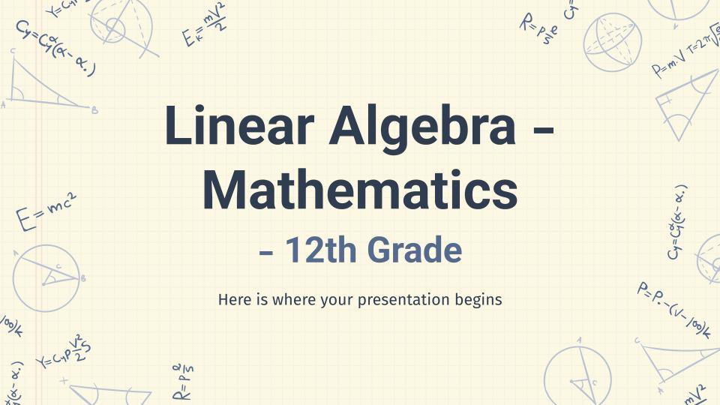
Computer mockup
You can replace the image on the screen with your own work. Just right-click on it and select “Replace image”

Slide 23
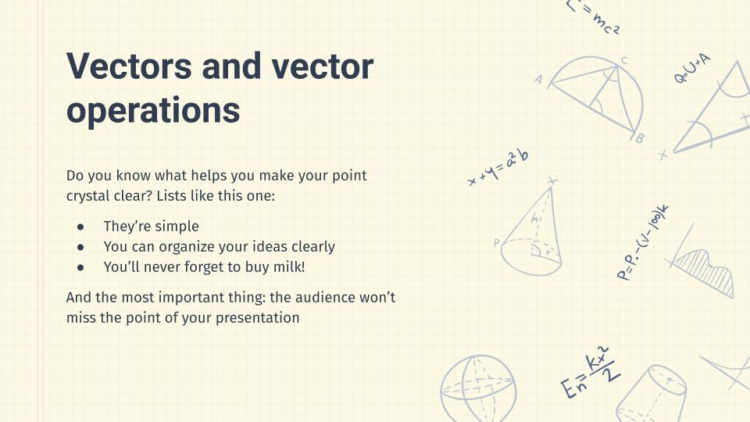
Tablet mockup
You can replace the image on the screen with your own work. Just right-click on it and select “Replace image”

Slide 24
Phone mockup
You can replace the image on the screen with your own work. Just right-click on it and select “Replace image”

Slide 25
This is a map
Venus
Venus is the second planet from the Sun
Mercury
Mercury is the closest planet to the Sun
Mars
Despite being red, Mars is a very cold place

Slide 26
How to apply linear algebra
Step 1
Step 2
Step 3
Step 4
Mars
Venus
Saturn
Jupiter
Despite being red, Mars is cold
Venus has a beautiful name
Saturn is a gas giant with rings
Jupiter is a very big planet

Slide 27
Linear algebra in 3D geometry
Earth
Venus
Earth is also known as the Blue Planet
Y
P (x,y,z)
Venus has extremely high temperatures
Y
X
Z
Z
Neptune
Moon
X
Neptune is very far away from the Sun
The Moon is Earth’s only natural satellite

Slide 28
Use tables to represent data
 | Team A | Team B | Team C
Topic 1 | Mercury is the smallest planet of them all | Venus is extremely hot, even more than Mercury | Earth is the third planet from the Sun and has life
Topic 2 | Despite being red, Mars is actually a cold place | Jupiter is the biggest planet in the Solar System | Saturn is a gas giant and has several rings
Topic 3 | Neptune is the farthest planet from the Sun | Pluto is now considered a dwarf planet | The Sun is the star at the center of the Solar System

Slide 29
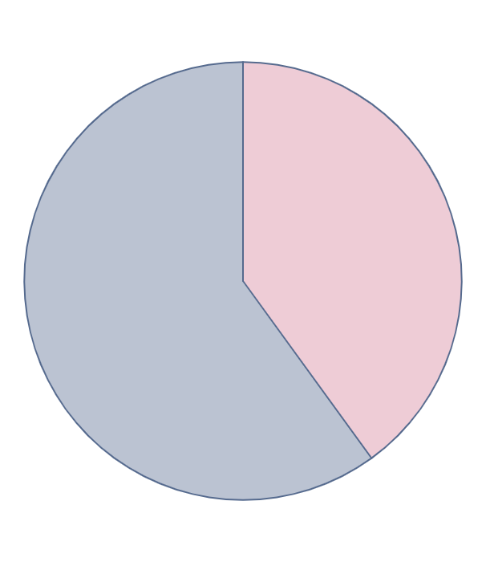
You can use this graph
60%
40%
Venus
Mercury
Venus has very high temperatures
Mercury is quite a small planet
Follow the link in the graph to modify its data and then paste the new one here. For more info, click here

Slide 30


Our team
Sofia Hill
Daniel Harris
You can speak a bit about this person here
You can speak a bit about this person here

Slide 31
Exercise: Solve the equation
Indicate the correct answer of the simple selection operation, indicate the correct answer by solving the equation in your blog of notes
Exercice 1: 5x−12=3
Exercice 2: 3x+1=x−3
Exercice 3: 5t+5=3t+7
A
x=3
A
x=6
A
t=5
B
x=6
B
x=-4
B
t=1
C
x= -1
C
x=−2
C
t=7
D
x=2
D
x=-5
D
t=12

Slide 32
Exercise: Right or wrong
In your notebook, solve the exercise provided, and carefully assess whether the solution to the equation is accurate or not. Make it clear whether the solution aligns correctly
Exercise
Answer
Right or wrong
A
3(2x+1)=−9
x=−2
Right
Wrong
B
2(2x−5)=3(x−1)−4
x=-3
Right
Wrong
C
3(z−2)+10=2(2z+2)+2
z=−2
Right
Wrong
D
3t+4(t−10)=t+20
t=10
Right
Wrong
E
3x+6(x+1)=3(x+1)+5
x= 1/6
Right
Wrong

Slide 33
Exercise: Common factor
Write the correct answer and develop the equation in your notebook
Exercise
Answer
A
Ax - bx =
B
my - mz =
C
X²a + X²b=
D
A³k - a²y=

Slide 34
Exercise: Order the steps
Following the steps, solve the following equation and indicate the result:
2y+3(2y−5)+4=y+3(2y−2)−6
Step 1
Step 2
Step 3
Simplify: We expand the parentheses and combine like terms
Clear the variable: We add 11 and subtract 7y from both sides
Solve: We no longer have to divide
Write the result here:

Slide 35
Thanks!
Do you have any questions?
youremail@freepik.com
+34 654 321 432
yourwebsite.com
Please keep this slide for attribution

